Slide 1
Stone Paper Scissors
A Mini Project in C
Academic Year: 2021-22 ODD SEMESTER
Department: B.Tech Computer science and Engineering
Semester: 1
Course Code: 18CSS101J
Course Title: Programming for Problem
Submitted by:
ISHAAN MANGLIK(RA2111027010194)
ANSH ASTHANA(RA2111027010205)
AANGAD CHHABRA(RA2111027010196)
DEPARTMENT OF COMPUTING COLLEGE OF ENGINEERING AND TECHNOLOGY

Slide 2
AIM: To create a game that allows users to play STONE PAPER SCISSOR with the computer in a neat and convenient manner.
ABSTRACT: Stone Paper Scissors is a childhood favorite of many, and works similarly on the computer to how it does in person. The player chooses to throw the stone, paper, or scissors, and the computer plays the same on the other side. There is an immediate winner, and the game challenges the player to try to think strategically to try to outsmart the computer.
Algorithm for paper stone scissors
STEP 1: Input V1 STEP 2:Input V2
STEP 3: If (v1 = stone) then STEP 4: If (v2 = stone) goto draw STEP 5: If (v2 = paper) goto lost
STEP 6: If (v2 = scissors) goto win
STEP 7: If (v1 = paper) then STEP 8: If (v2 = stone) goto win STEP 9:If (v2 = paper) goto draw
STEP 10:If (v2 = scissors) goto lost
STEP 11: If (v1 = scissors) then STEP 12: If (v2 = stone) goto lost STEP 13: If (v2 = paper) goto win STEP 14: If (v2 = scissors) goto draw
STEP 15: // if we got here, something was wrong with input values STEP 16: print error message; goto exit
STEP 17:draw: print draw message; goto exit STEP 18: Lost: print lost message; goto exit STEP 19: win: print win message; goto exit STEP 20: exit: exit the program

Slide 3
SOURCE CODE
// C program for the above approach #include <math.h>
#include <stdio.h> #include <stdlib.h> #include <time.h>
// Function to implement the game int game(char you, char computer)
{
// If both the user and computer
// has chose the same thing if (you == computer)
return -1;
// If user's choice is stone and
// computer's choice is paper
if (you == 's' && computer == 'p') return 0;
// If user's choice is paper and
// computer's choice is stone
else if (you == 'p' && computer == 's') return 1;
// If user's choice is stone and
// computer's choice is scissor
if (you == 's' && computer == 'z') return 1;
// If user's choice is scissor and
// computer's choice is stone
else if (you == 'z' && computer == 's') return 0;
// If user's choice is paper and
// computer's choice is scissor
if (you == 'p' && computer == 'z') return 0;
// If user's choice is scissor and

Slide 4
// computer's choice is paper
else if (you == 'z' && computer == 'p') return 1;
}
// Driver Code int main()
{
// Stores the random number int n;
char you, computer, result;
// Chooses the random number
// every time srand(time(NULL));
// Make the random number less
// than 100, divided it by 100 n = rand() % 100;
// Using simple probability 100 is
// roughly divided among stone,
// paper, and scissor if (n < 33)
// s is denoting Stone computer = 's';
else if (n > 33 && n < 66)
// p is denoting Paper computer = 'p';
// z is denoting Scissor else
computer = 'z';
printf("\n\n\n\n\t\t\t\tEnter s for STONE, p for PAPER and z for SCISSOR\n\t\t\t\t\t\t\t");
// input from the user scanf("%c", &you);
// Function Call to play the game result = game(you, computer);
if (result == -1) {

Slide 5
printf("\n\n\t\t\t\tGame Draw!\n");
}
else if (result == 1) {
printf("\n\n\t\t\t\tWow! You have won the game!\n");
}
else {
printf("\n\n\t\t\t\tOh! You have lost the game!\n");
}
printf("\t\t\t\tYOu choose : %c and Computer choose : %c\n",you, computer);
return 0;
}

Slide 6
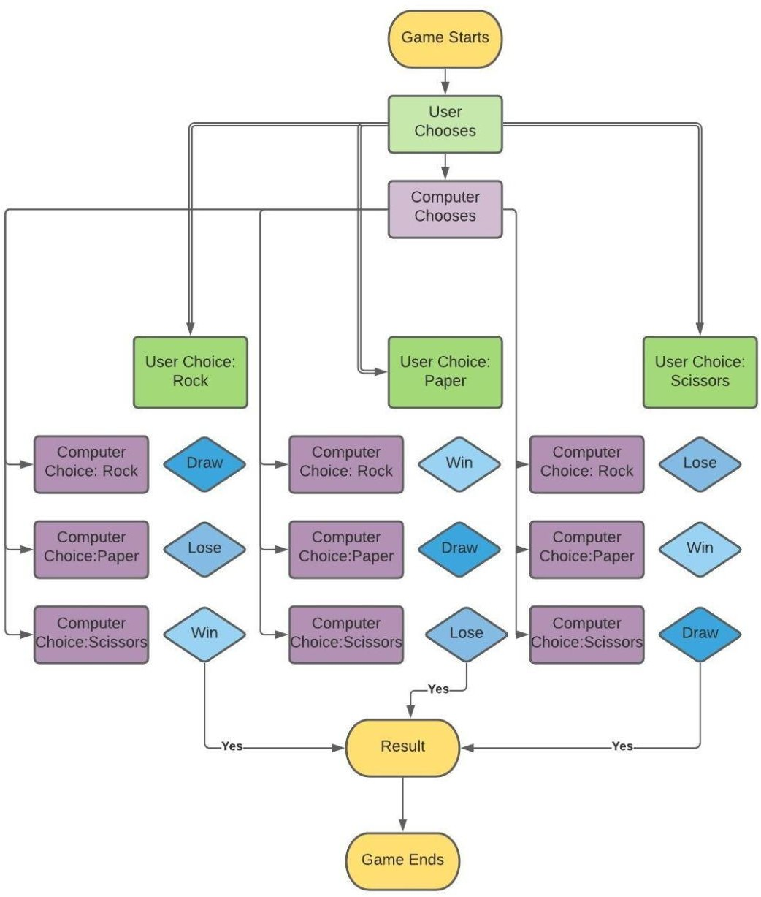
FLOWCHART

Slide 7
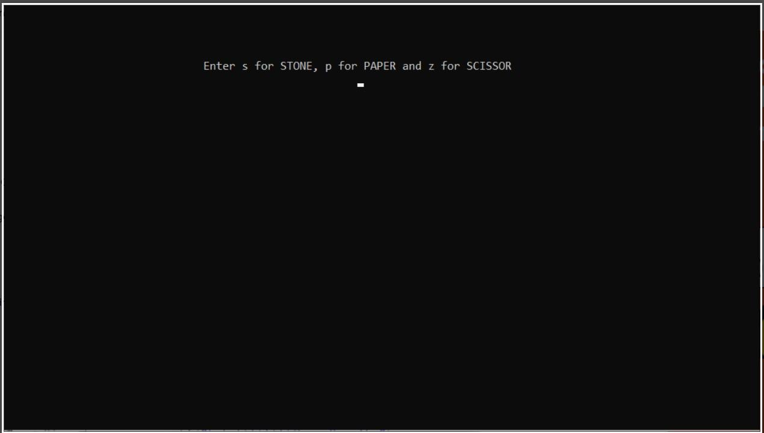
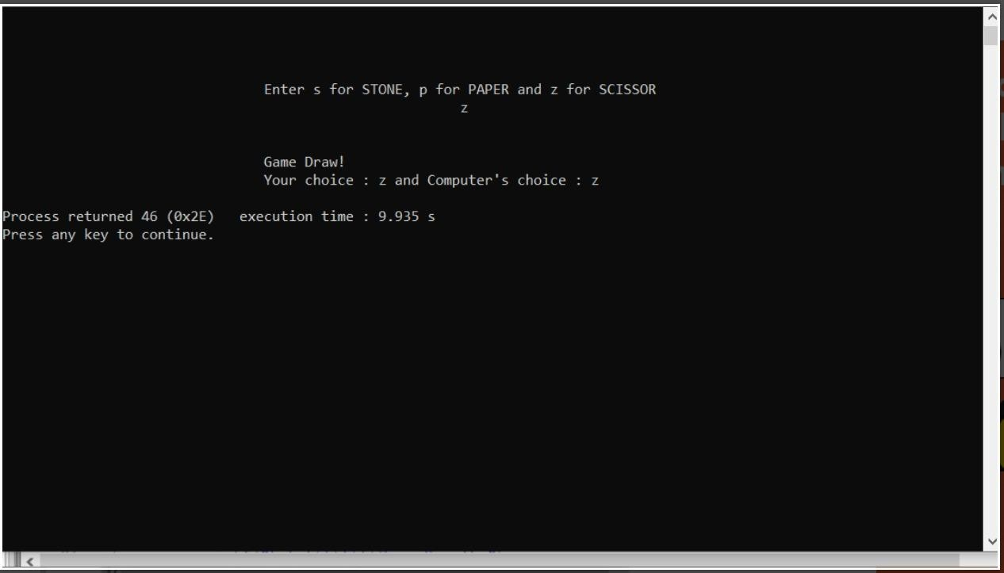
OUTPUT

Slide 8
RESULT
Our project Stone Paper Scissor provides easy access to a formatted game. Our project has succeeded in managing the data and providing the best output.
CONCLUSION:
Stone Paper Scissors has been a hit with all age groups tested. It is a classic game that is enhanced through picture animations. However, in the future, these images could be programmed to look nicer rather than showing as a plain figure window. Also, different versions of the game could be added so the user could choose which version they would like to play.

